Slide 1
A Variational Quantum Classifier Approach to Multi-Age Autism Spectrum Disorder Detection
Dave Machnaim
Division of Artificial Intelligence and Machine Learning
Karunya Institute of Technology and Sciences
davemachnaim@karunya.edu.in
D Narmadha Naveen
Division of Artificial Intelligence and Machine Learning
Karunya Institute of Technology and Sciences
narmadha@karunya.edu

Slide 2
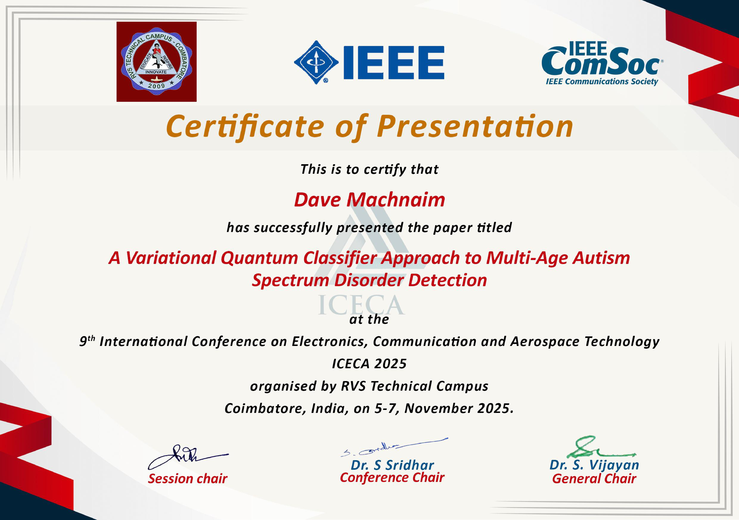
CONFERENCE CERTIFICATE

Slide 3
The Challenge in ASD Diagnostics
The Problem:
Autism Spectrum Disorder (ASD) is a complex neurodevelopmental condition.
Traditional diagnostics rely on behavioral observation and expert interpretation.
The Challenges:
Subjective: Prone to inter-rater and cultural bias.
Resource-Intensive: Requires significant clinical time and expertise.
Scalability Issues: Difficult to apply broadly and early.
The Goal:
Develop computational screening tools to improve accuracy, objectivity, and scalability.

Slide 4
Our Approach: Objectives & Contributions
Objectives:
To develop a hybrid classical–quantum framework for ASD classification.
To apply a Variational Quantum Classifier (VQC) to multi-age screening datasets (child, adolescent, and adult).
To evaluate the model's performance and training behavior against classical methods.
Key Contributions:
A novel hybrid pipeline integrating classical pre-processing, a quantum VQC, and classical post-processing.
Achieved perfect (100%) evaluation metrics in simulation, surpassing established classical baselines.
Provided one of the first VQC demonstrations for structured, multi-age ASD screening data, moving beyond typical fMRI analysis.

Slide 5
Literature Review: The Current Landscape
What others have done:
Classical ML (SVM, k-NN, Ensembles):
Widely used for structured data.
Often achieve high accuracy (90-99%) but can struggle with noisy or imbalanced datasets.
Deep Learning (CNN, LSTM):
Very effective for complex data like fMRI or sMRI.
Often data-hungry and computationally expensive.
The Gap:
Quantum Machine Learning (QML) is rarely explored for this type of structured, questionnaire-based ASD data.
Most QML studies focus on neuroimaging or single-age cohorts.
We see an opportunity to use a VQC's ability to model complex, non-linear feature interactions in a high-dimensional space.

Slide 6
Dataset Description
Source: A composite dataset from the UCI Machine Learning Repository and Kaggle.
Cohorts: Merged data from Children, Adolescents, and Adults.
Total Samples: 947
Attributes (21 total):
Behavioral: Q-CHAT-10 screening items.
Demographic: Age, Gender, Ethnicity.
Contextual: Jaundice at birth, Family history of ASD.
Target: Binary 'Class/ASD' label (ASD-Positive / ASD-Negative).
Preprocessing:
One-hot encoding for categorical features.
Z-score normalization for continuous features.
Stratified sampling to ensure class balance.

Slide 7
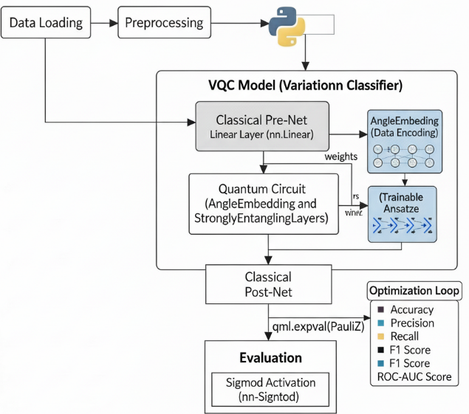
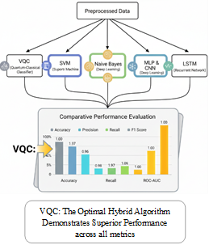
VQC-Hybrid Architecture

Slide 8
Proposed Methodology
The VQC-ASD Hybrid Framework
1. Classical Pre-processing:
A classical Dense Layer projects the 21 input features down to 2 features.
This acts as a dimensionality reduction step to match our 2-qubit register.
2. Quantum Circuit (VQC):
The 2 features are encoded into the quantum state.
Trainable entangling layers process the data.
3. Classical Post-processing:
The quantum circuit is measured, producing 2 classical values.
A final Dense Layer with a Sigmoid function interprets these values to make the final (0 or 1) classification.

Slide 9

Inside the Quantum Circuit (VQC)
The Quantum Core:
Step 1: Encoding (Angle Embedding)
The 2 classical features $\left(x_{1},x_{2}\right)$are "loaded" into the qubits by rotating them.
We use AngleEmbedding, which applies an $R_{y}$ rotation gate based on the feature value.
$\left|Ψ\right\rangle =R_{y}\left(x_{1}\right)⊗R_{y}\left(x_{2}\right)\left|00\right\rangle$
Step 2: Entanglement (Variational Layer)
We apply StronglyEntanglingLayers.
This is a repeating block of single-qubit rotations and CNOT (entangling) gates.
These layers have trainable parameters $(θ)$ that are learned during optimization.
This is what allows the circuit to learn complex correlations.
Step 3: Measurement
We measure the Pauli-Z expectation value of each qubit.
This returns two classical values, $\left\langle Z_{1}\right\rangle ,\left\langle Z_{2}\right\rangle$, which are fed to the next classical layer.

Slide 10
End-to-End Training
Framework: PennyLane (for Quantum) + PyTorch (for Classical).
End-to-End Differentiation: The entire model is differentiable.
Classical gradients are computed via standard backpropagation.
Quantum gradients are computed using the parameter-shift rule.
Optimization:
Loss Function: Binary Cross-Entropy (BCE)
Optimizer: Adam
Learning Rate: 0.01
Epochs: 70
This allows the classical layers and the quantum circuit to be trained simultaneously as a single, unified network.

Slide 11
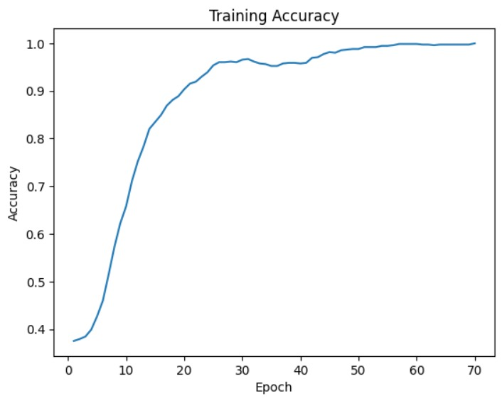
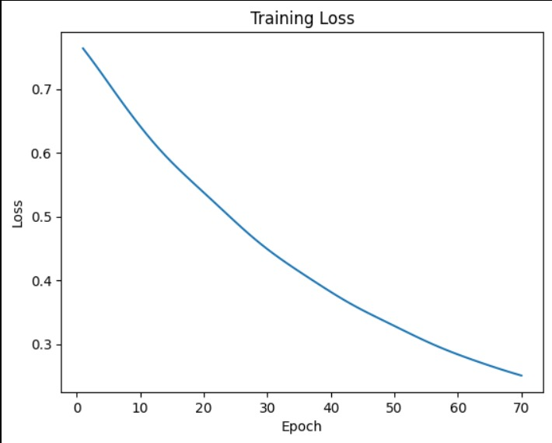
Results:
Training Performance
Training Stability
Accuracy: Smoothly converged from 37.5% to 100% by epoch 70.
Loss: Steadily decreased from 0.76 to 0.25.
Finding: The model exhibited stable convergence, indicating effective learning without instability or overfitting on this dataset.
Metric of Evaluation | Scores
Accuracy | 1.00
Precision | 1.00
Recall | 1.00
F1-Score | 1.00
Evaluation Metrics

Slide 12
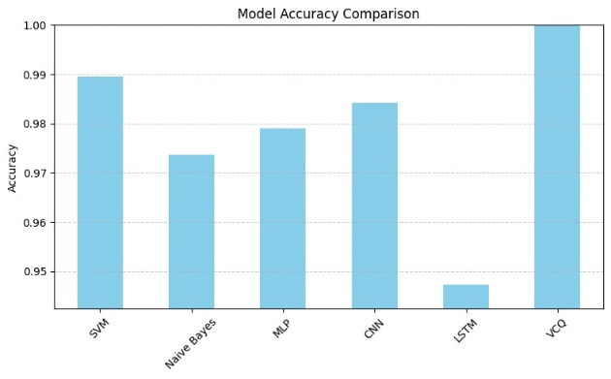
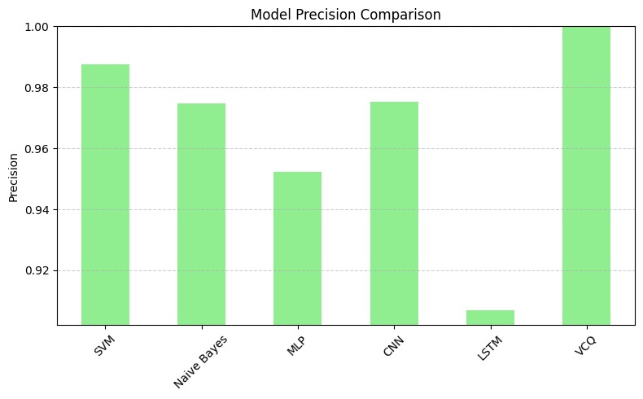
Results: Comparative Analysis Accuracy & Precision
Comparison with Classical & Deep Learning Models
Our VQC-ASD Model (in yellow) achieved 100% in both Accuracy and Precision.
This performance exceeded all classical baselines, including SVM, Naive Bayes, MLP, CNN, and LSTM, which ranged from 94-99%.

Slide 13
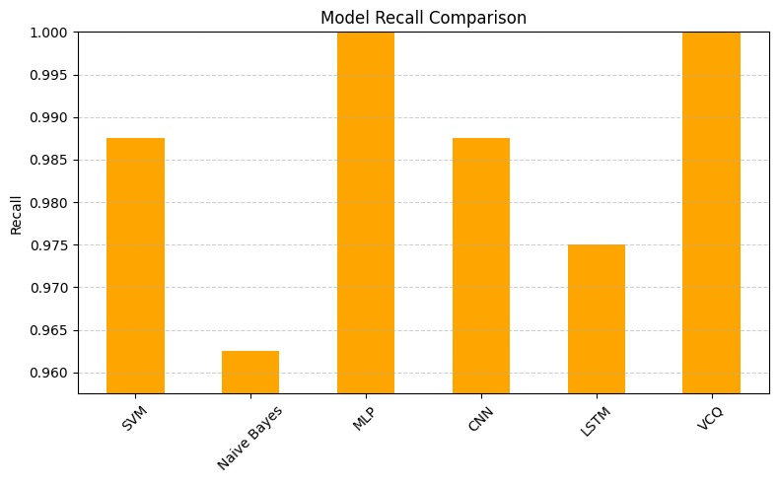
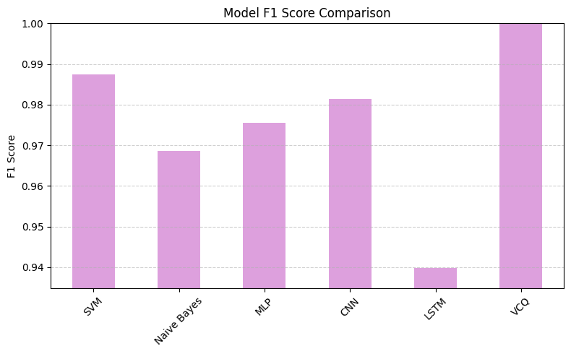
Results: Comparative Analysis Recall & F1-Score
Comparison with Classical & Deep Learning Models
The trend continues for Recall and F1-Score.
The VQC model again achieved a perfect score of 1.00.
Conclusion: The hybrid VQC framework demonstrates a superior ability to find the decision boundary in this dataset compared to state-of-the-art classical and deep learning approaches.

Slide 14
Limitations
Noiseless Simulator:
These results were achieved on a default.qubit simulator.
Performance on real quantum hardware (NISQ devices) will be impacted by noise, which could degrade accuracy.
Dataset Size:
The model was validated on 947 samples.
Broader validation on larger, more diverse clinical cohorts is a necessary next step.
Proof-of-Concept:
This study establishes a proof-of-concept. It is not yet a clinically deployable tool.

Slide 15
Conclusion & Future Work
Future Work:
Hardware Deployment: Test the model's robustness on real NISQ (Noisy Intermediate-Scale Quantum) hardware.
Dataset Expansion: Validate the framework on larger, more diverse clinical screening datasets.
Architectural Exploration: Experiment with deeper quantum circuits, alternative encoding strategies, and noise-mitigation techniques.
Conclusion:
We successfully designed a hybrid classical–quantum framework (VQC-ASD) for detecting ASD across multi-age groups.
The model achieved perfect 100% performance on the test dataset, outperforming all classical and deep learning baselines.
This work provides a strong proof-of-concept for leveraging quantum-enhanced learning in behavioral health analytics.

Slide 16
THANK YOU
Dave Machnaim​
9900416282
davemachnaim@karunya.edu.in

